Slide 1
SAT – 5114 IMAGE SEGMENTATION FOR BRAIN TUMOR DETECTION
PRESENTED BY:-
VISHWAJEETH BALAJI
NAGENDRA MADI REDDY

Slide 2
TABLE OF CONTENTS
Introduction
Making Mask
Preparing Data
Building U-Net CNN Model
Training the model
Model Evaluation on Training Data
Model Evaluation on Testing Data
Final Results
References

Slide 3
INTRODUCTION
Brain tumors can be challenging to detect and diagnose accurately, especially in their early stages. Image segmentation techniques help in precisely delineating the boundaries of tumors from medical imaging such as MRI or CT scans. By using CNN UNET models, which are specifically designed for biomedical image segmentation, we can achieve high levels of accuracy in identifying tumor regions. This accuracy is crucial for doctors to make informed decisions about treatment options and to monitor the progression of the disease.
Once a brain tumor is detected, treatment planning becomes essential. Precise segmentation of the tumor region allows clinicians to determine the size, shape, and location of the tumor relative to critical structures in the brain. This information is vital for planning surgical interventions, radiation therapy, or chemotherapy. Moreover, by monitoring changes in the tumor over time through sequential imaging, doctors can assess the effectiveness of treatment and make adjustments as necessary. UNET model provide a reliable tool for consistently and objectively segmenting tumor regions, thereby facilitating more accurate treatment planning and monitoring.

Slide 4
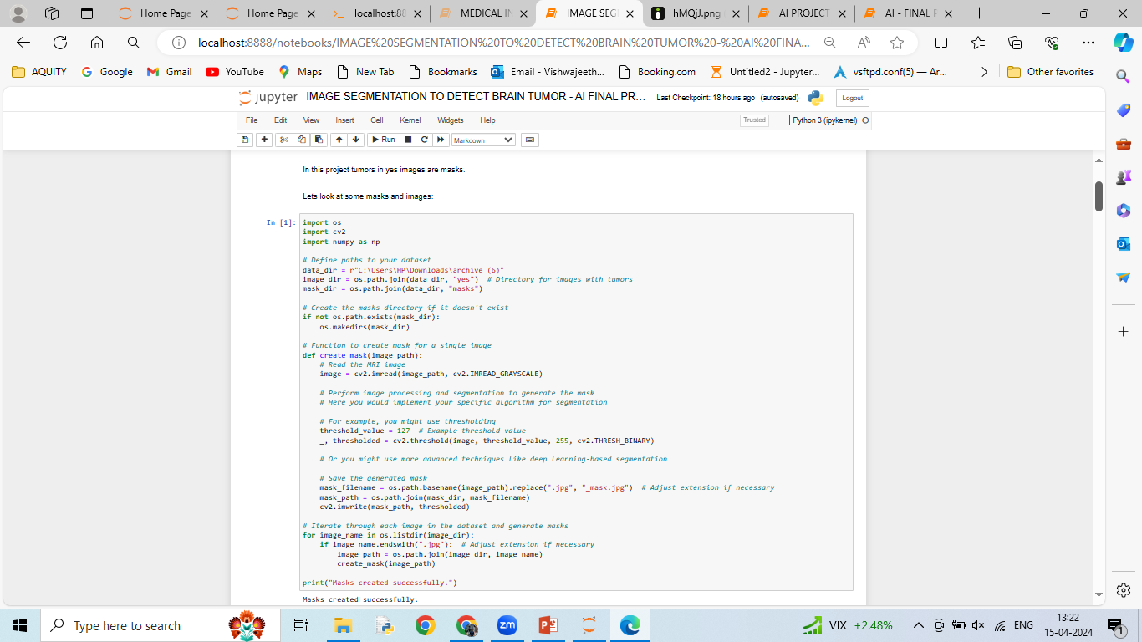
MAKING MASK
The provided code defines a process for generating masks for MRI images depicting tumors. It first establishes paths to the dataset directory, images with tumors, and the directory where the masks will be stored. If the mask directory doesn't exist, it creates one. The core of the mask generation process lies within the create_mask function. This function reads each MRI image in grayscale, applies segmentation techniques (such as thresholding) to isolate the tumor regions, and saves the resulting masks in the designated mask directory. The code then iterates through each image in the dataset directory, calling the create_mask function for each image with a .jpg extension to generate the corresponding mask. Finally, it prints a message confirming successful mask creation. However, the specific segmentation algorithm to extract tumor regions is left as a placeholder within the create_mask function, indicating that users must implement their segmentation method based on the dataset characteristics and requirements

Slide 5
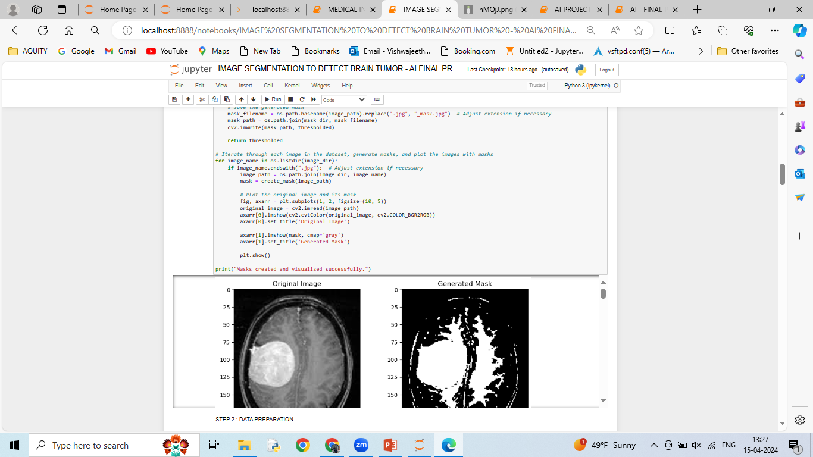
MASK VISUALIZATION
Using Matplotlib, the code plots the original MRI image and its corresponding mask side by side in a single figure. The original image is displayed in its true colors, while the generated mask is shown in grayscale to highlight the segmented tumor regions. This visualization enables a quick qualitative assessment of the effectiveness of the segmentation algorithm and provides insights into the distribution and coverage of the tumor regions within the images. Additionally, a message confirming successful mask creation and visualization is printed at the end of the process.

Slide 6
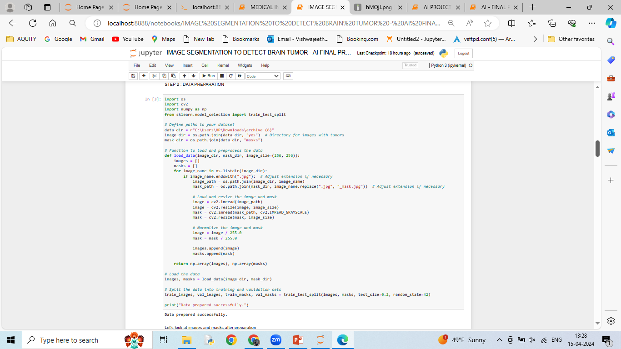
DATA LOADING & SPLITTING
Our code defines a load_data function to load and preprocess MRI images and their corresponding masks from the specified directories. It iterates through each image file in the image directory, loads the image and its corresponding mask, resizes them to a specified size (default is 256x256 pixels), and normalizes the pixel values to the range [0, 1]. The preprocessed images and masks are then returned as NumPy arrays.
The load_data function is called to load the images and masks from the specified directories. The loaded data is then split into training and validation sets using the train_test_split function from scikit-learn. The split ratio is set to 0.2, indicating that 20% of the data will be used for validation, while the remaining 80% will be used for training. The random state is set to 42 for reproducibility. Finally, a message confirming successful data preparation is printed.

Slide 7
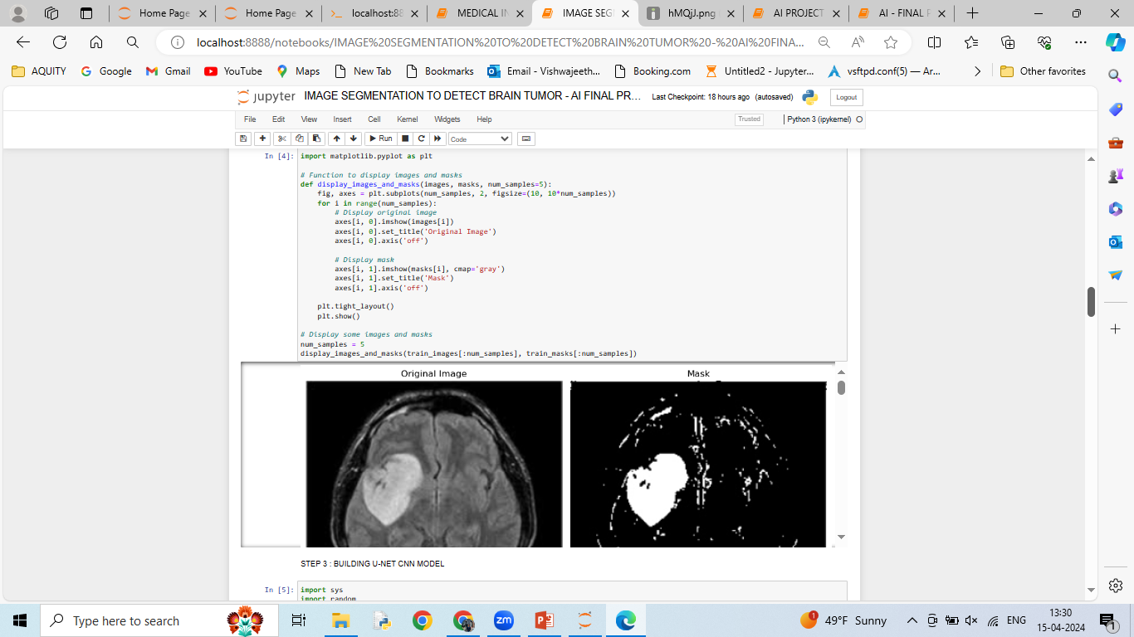
IMAGE & MASK VISULAIZATION AFTER DATA PREPARATION
The display_images_and_masks function is called to visualize a subset of training images and their masks. The number of samples to be displayed is set to 5 by default. It selects the first num_samples images and masks from the training set and passes them to the visualization function. This allows users to quickly inspect the quality of the training data and verify that the masks align correctly with the corresponding images.

Slide 8
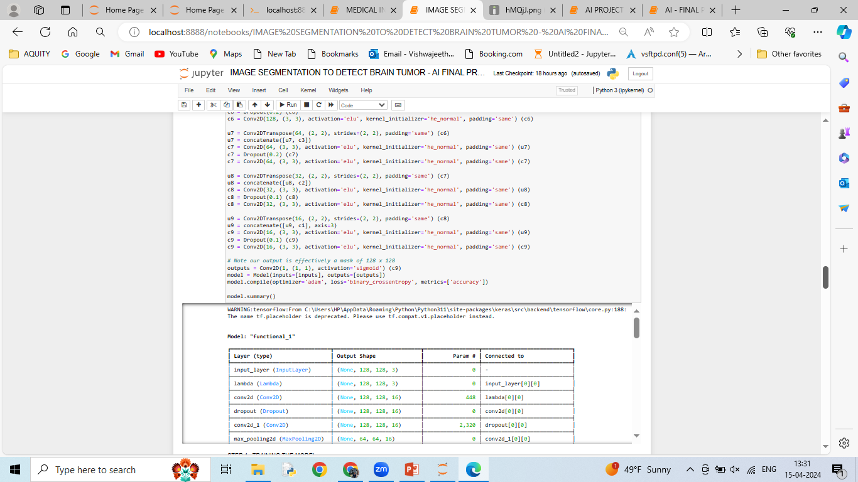
U-NET ARCHITECTURE AND MODEL COMPILATION
The provided code constructs a U-Net model for image segmentation. The U-Net architecture consists of an encoding path (contracting path) followed by a decoding path (expansive path). The encoding path consists of convolutional layers followed by max-pooling layers to capture hierarchical features. The decoding path consists of transpose convolutional layers (also known as upsampling or deconvolution) followed by concatenation with corresponding feature maps from the encoding path and convolutional layers to recover spatial information. Skip connections between encoding and decoding layers help to preserve spatial information and facilitate gradient flow during training.
The U-Net model is compiled using the Adam optimizer and binary cross-entropy loss function, which is suitable for binary segmentation tasks. The metric used for evaluation is accuracy. The model summary provides a detailed overview of the network architecture, including the number of parameters in each layer and the output shape at each stage, aiding in model inspection and debugging.

Slide 9
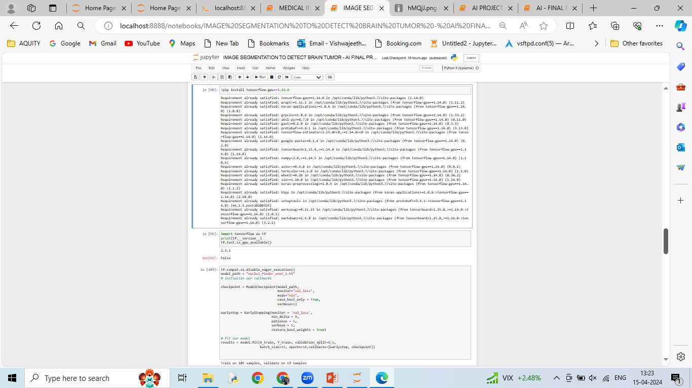
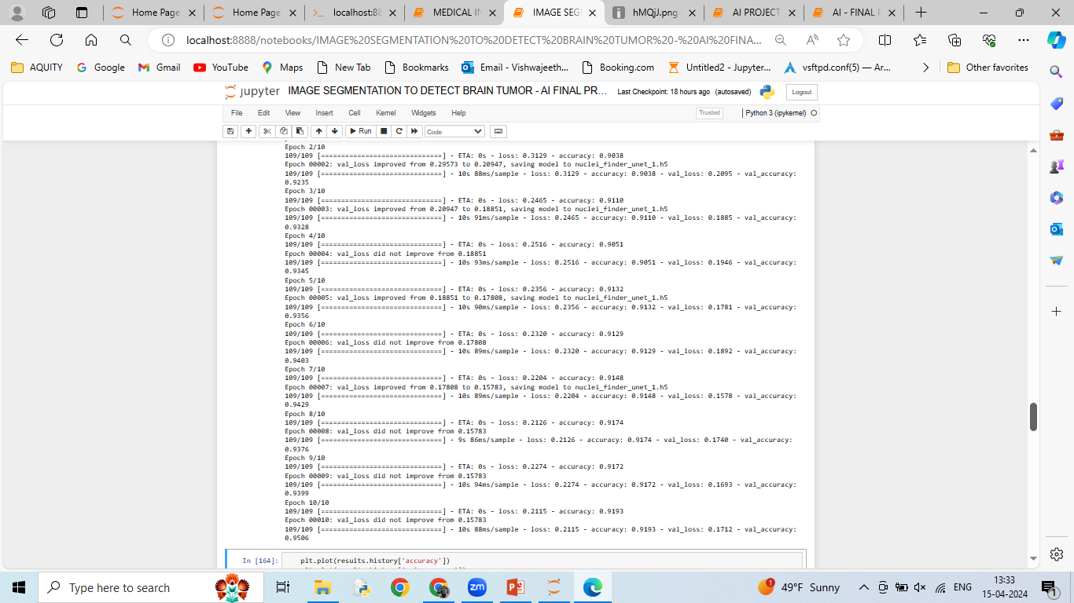
TENSOR FLOW INSTALLATION AND MODEL TRAINING
The code installs TensorFlow-GPU version 1.14.0 using pip and checks the TensorFlow version, which is 2.3.1. Additionally, it verifies whether a GPU is available for computations, and the output indicates that GPU support is not available.
The code initializes callbacks for model training, including ModelCheckpoint and EarlyStopping. ModelCheckpoint saves the model weights based on validation loss, ensuring that only the best-performing model is retained. EarlyStopping monitors the validation loss and stops training if the loss does not improve for a specified number of epochs (patience). The model is then trained using the fit method, with training data (X_train, Y_train), a validation split of 0.1, a batch size of 16, and a maximum of 10 epochs. The callbacks are passed to the fit method to facilitate model checkpointing and early stopping.

Slide 10
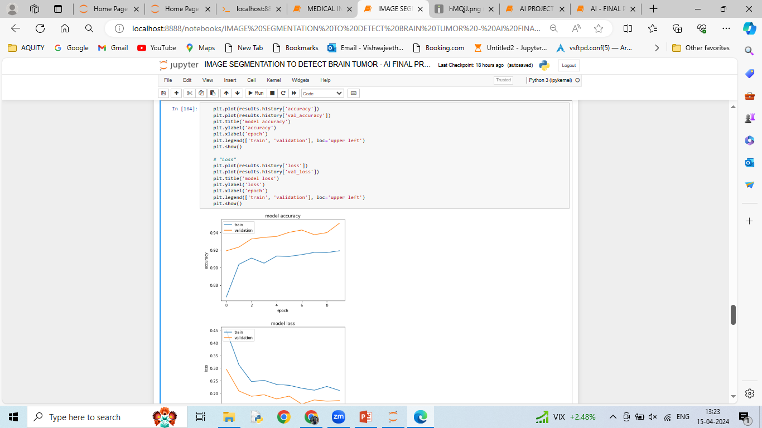
PLOTTING THE MODEL ACCURACY AND LOSS
The code generates a plot showing the model's training and validation accuracy across epochs. It plots the training accuracy and validation accuracy against the number of epochs. This visualization helps assess the model's performance over the training period, indicating whether it is learning effectively and if there is overfitting or underfitting.
Another plot is generated to visualize the training and validation loss over epochs. Similar to the accuracy plot, this plot displays the training loss and validation loss against the number of epochs. Monitoring loss helps to understand the convergence behavior of the model during training, identifying whether it is decreasing steadily or fluctuating.

Slide 11
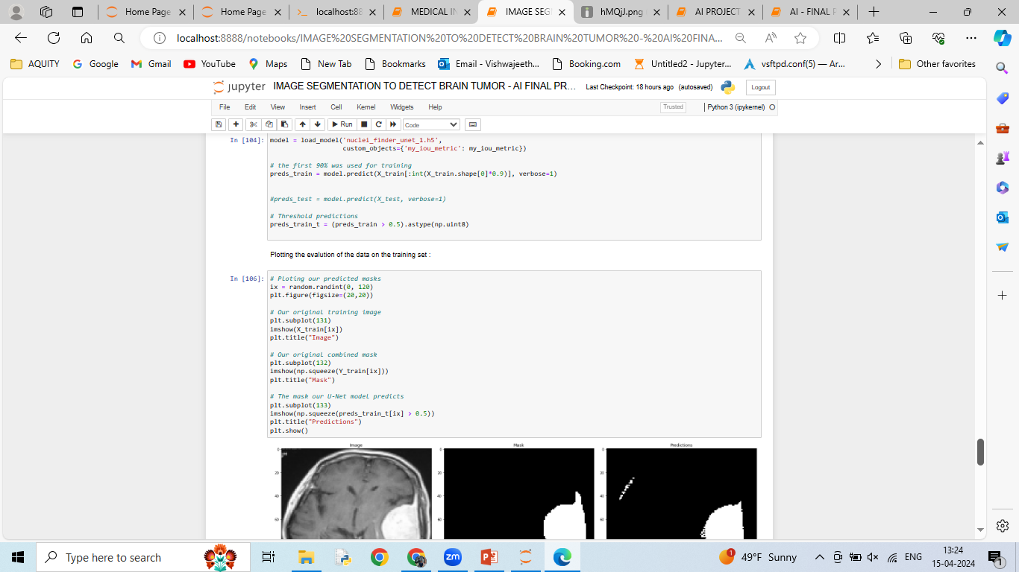
MODEL EVALUATION ON TRAINING DATA
The code loads a trained U-Net model (‘tumor_finder_unet_1.h5') and makes predictions on the training dataset. It applies the model to the first 90% of the training data and thresholds the predictions using a threshold of 0.5. The resulting predicted masks are visualized alongside the original training images and their corresponding ground truth masks.
The code randomly selects an index from the training dataset, displaying the original training image, its corresponding ground truth mask, and the predicted mask generated by the U-Net model. This visualization allows for a qualitative assessment of the model's performance in segmenting nuclei from the microscopy images.

Slide 12
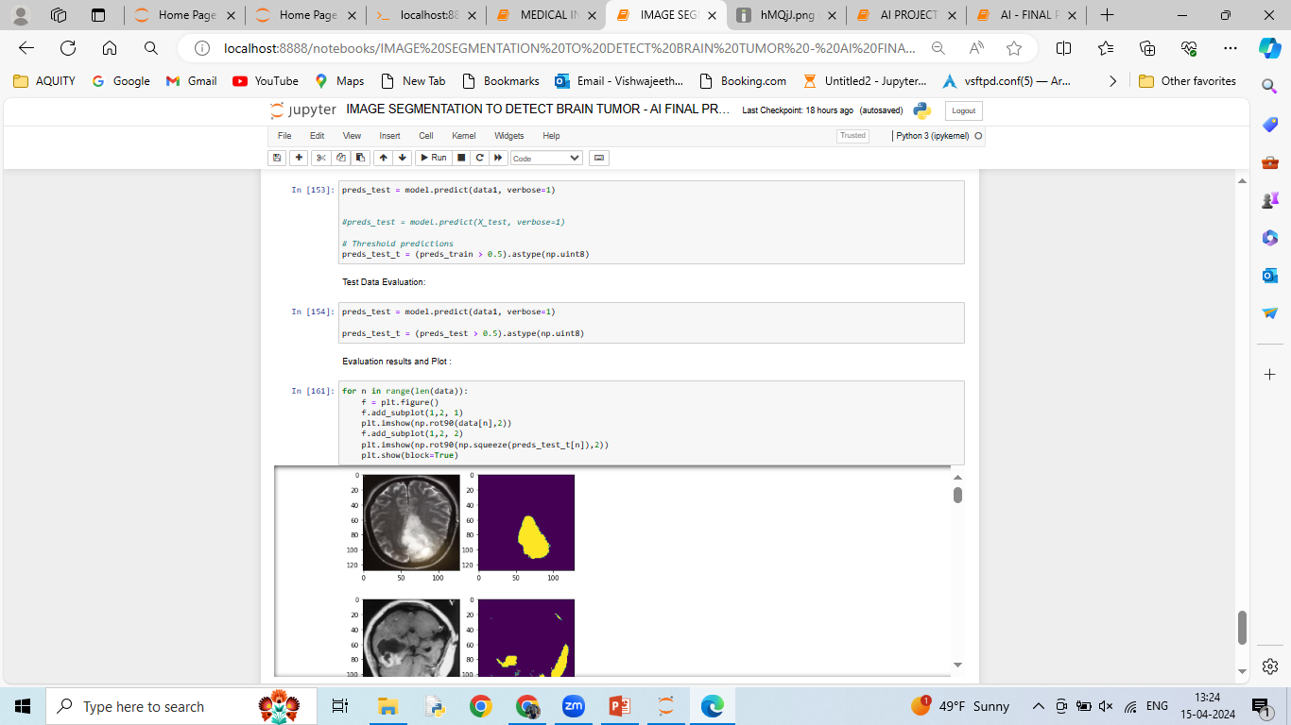
MODEL EVALUATION ON TESTING DATA
The code reads test images from the specified directory, resizes them to a size of 128x128 pixels using cubic interpolation, and stores them in an array. It then utilizes the trained U-Net model to predict segmentation masks for the test data.
After obtaining predictions for the test data, the code applies a threshold of 0.5 to the predicted masks to obtain binary segmentation results. It then iterates over each test image, displaying the original image alongside its corresponding predicted mask. This visualization allows for a qualitative assessment of the model's performance on unseen test data, aiding in understanding its generalization capabilities.

Slide 13
RESULTS & CONCLUSION
Utilizing a U-Net convolutional neural network for brain tumor segmentation presents a promising avenue in medical imaging analysis. While initial results on test data may be satisfactory, continuous refinement of the model is essential for further improvement. Enhancements can be achieved through fine-tuning hyperparameters, adjusting network architecture, and implementing sophisticated loss functions. Designing a custom accuracy metric tailored to tumor segmentation nuances could significantly improve performance by accurately reflecting clinical relevance. Techniques like data augmentation, ensemble learning, and transfer learning from related tasks can also enhance efficacy. Leveraging advanced optimization algorithms and exploring state-of-the-art architectures are vital for refining the segmentation process. Continuous iteration and experimentation are key in maximizing model performance, leading to more accurate diagnoses in clinical settings.

Slide 14
THANK YOU

